Slide 1






By Dennis Maxwell
3MTT C2
CAPSTONE PROJECT

Slide 2
Title: Analyzing Global COVID-19 Trends
Subtitle: Forecasting, Classification, and Interactive Visualization
Author: Dennis Maxwell - FE/23/29787163
Track: Data Science
Date: November 2024

Slide 3
Abstract
The COVID-19 pandemic has profoundly impacted public health and global economies.

Slide 4
Goals and Objectives:
Analyze COVID-19 trends globally.
Predict future case trajectories using time-series modeling.
Identify high-mortality countries through classification models.
Develop an interactive dashboard for stakeholder engagement.

Slide 5
Methodology
Data Collection:
Preprocessing
Exploratory Analysis
Modeling:

Slide 6
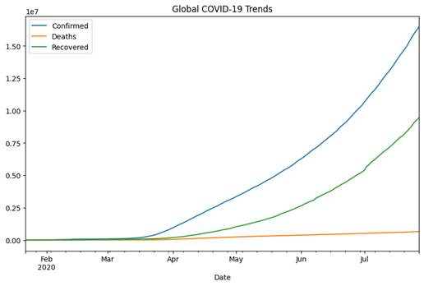
Results
EDA Insights:

Slide 7
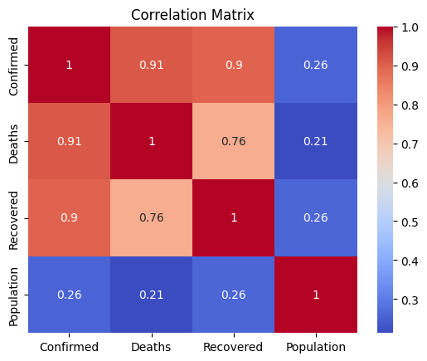
Results
Correlation Analysis:

Slide 8
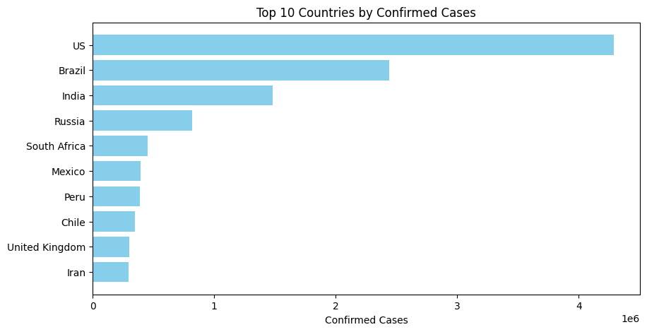
EDA Insights:

Slide 9
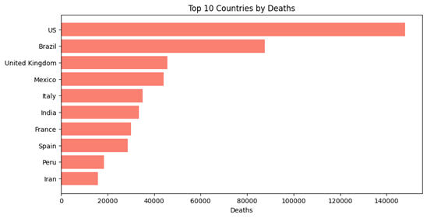
EDA Insights:

Slide 10
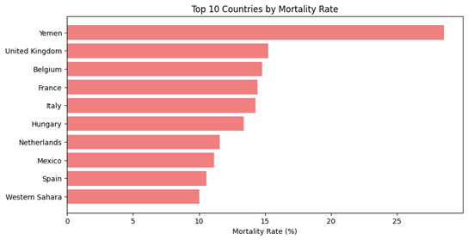
EDA Insights:

Slide 11
Time-Series Forecasting:
ARIMA model results:
MAE: 214,000 cases.
RMSE: 305,000 cases.

Slide 12
Classification Outcomes:
Logistic Regression: 82% accuracy.
Random Forest: 87% accuracy.
XGBoost: 89% accuracy (Best performer).

Slide 13
Interactive Dashboard
Features:
Time-series plots and global maps.
Dropdown for country selection.

Slide 14
Discussion
Key Insights:
Higher healthcare burdens correlate with increased mortality.
XGBoost effectively identifies high-risk regions.
Advanced models needed for better forecasting.

Slide 15
Limitations:
Limited real-time data integration.
Economic and vaccination data excluded.

Slide 16
Conclusion
This study demonstrates the utility of integrating statistical, machine learning, and visualization techniques to analyze COVID-19.

Slide 17
THANK YOU

